Slide 1
Routing Algorithms

Slide 2
Definition
Routing –
The act of moving information across an inter-network from a source to a destination
Process of choosing a path over which to send the packets
“A name indicates what we seek. An address indicates where it is. A route indicates how we get there.” -- Jon Postel
Routing Algorithm –
The part of the network layer software responsible for deciding which output line an incoming packet should be transmitted on, i.e. what should be the next intermediate node for the packet

Slide 3
Desirable Properties of Routing Algorithm (1/2)
Correctness
Packets to be delivered correctly/accurately
Simplicity
Functionality to be delivered efficiently
Low overhead (since limited resources)
Robustness
Resistant to failures (hw/sw)
Ability to cope with changes in the topology and traffic without requiring all jobs in all hosts to be aborted
Stability
Converge (agreement among all routers on optimal routes. Routers distribute routing update messages that permeate networks, stimulating recalculation of optimal routes and eventually causing all routers to agree on these routes) to equilibrium fast in the face of changing conditions in the network
Fairness
Efficiency
compromise between global efficiency and fairness to individual connections is needed
Contradictory Goals

Slide 4
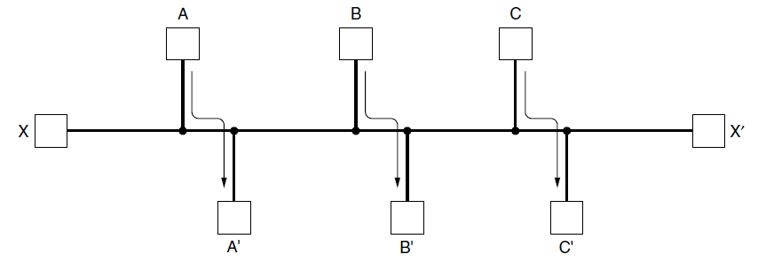
Desirable Properties of Routing Algorithm (2/2) : Fairness vs Efficiency
Suppose that there is enough traffic between A and A′, between B and B′, and between C and C′ to saturate the horizontal links.
To maximize the total flow, the X to X′ traffic should be shut off altogether
Here
Global Efficiency would be High
Fairness to individual connection Low (X - X′)

Slide 5
Design Parameters -
While designing a routing algorithm 2 important parameters taken into account:
Performance Criteria / Metric:
Number of hops, weight, Delay, Throughput, etc
Decision Time:
Per packet basis (Datagram)
Per session (Virtual-circuit)

Slide 6
Types of Routing Algorithms
Non-Adaptive Routing Algorithms
Do not base their routing decisions on any estimates of the current topology and traffic
Choice of route computed in advance
a.k.a Static Routing
Adaptive Routing Algorithms
Change routing decisions to reflect changes in the topology, and sometimes changes in the traffic as well
a.k.a Dynamic Routing

Slide 7
References
http://www.nptel.ac.in/courses/106105080/pdf/M7L1.pdf
https://www.cisco.com/cpress/cc/td/cpress/fund/ith2nd/it2405.htm

